Slide 1
Apprenticeship at igus

Slide 2
My presentation
About me
About igus
What is igus
My Apprenticeship
Summary

Slide 3
ME
Jeremy Görzen
19 Years
igus GmbH
Georg-Simon-Ohm Berufskollege
IT-Spezialist focusing on system integration

Slide 4

GmbH
Since 1964
About 4.600 Employees around the world
→ 80 countries
born in Köln-Lind
Leading manufacturer of motion plastics®

Slide 5
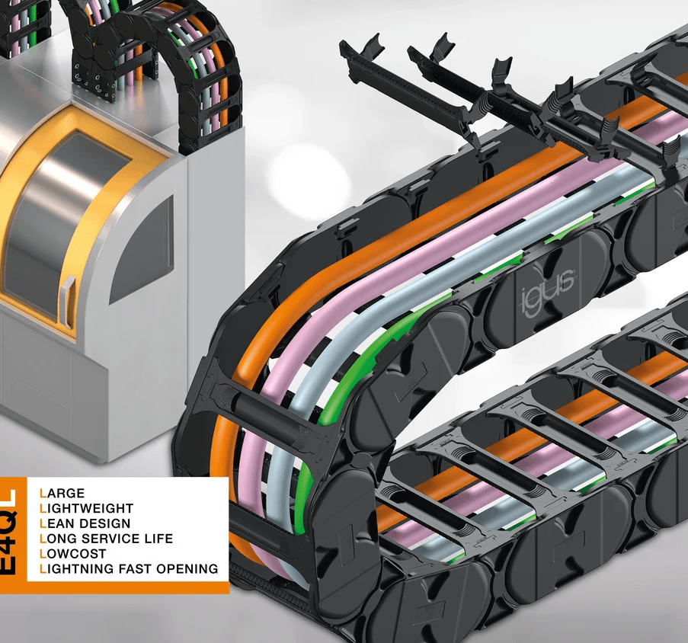
What is igus
Manufacturer of high-performance polymers
Industrial injection moulding
Motion plastics – Zero Oil
Largest test laboratory in the industry - 15.000 tests/Year

Slide 6
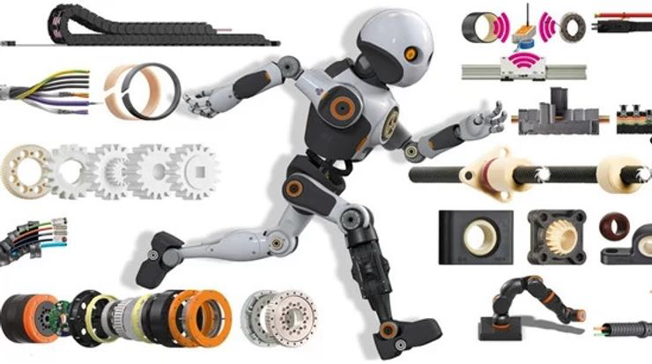


Igus goals
Improve what moves
Zero plastic waste
Easiest company to deal with

Slide 7
Apprenticeship
System integrator
igus DigITal
Service Desk
Telephone support
Hardware installation
Software solutions

Slide 8
Summary
Me
Igus
What igus is
The goals of igus
My apprenticeship at igus

Slide 9
Any questions?

